Slide 1

Exploratory Factor Analysis
Note: The research reported here was supported by the Institute of Education Sciences, U.S. Department of Education, through Grant R305E150006 to the Regents of the University of California. The opinions expressed are those of the authors alone and do not represent views of the Institute or the U.S. Department of Education, or of the agencies providing data.

Slide 2
Overview
Factor Analysis with Principal Factoring method
Using survey questions pooled means
Factor Loadings table and screeplots
Retain factors with eigenvalues > 1

Slide 3
Secondary Factor Loadings
 | Factor1 | Factor2 | Factor3 | Factor4 | Factor5 | Factor6 | Factor7 | Factor8 | Factor9
qoi22mean_pooled | 0.67 | -0.43 | -0.15 | -0.37 | -0.12 | -0.04 | 0.04 | 0.02 | 0.01
qoi23mean_pooled | 0.87 | -0.11 | 0.16 | -0.20 | 0.00 | -0.16 | -0.09 | -0.01 | -0.02
qoi24mean_pooled | 0.91 | -0.11 | 0.12 | -0.26 | -0.03 | -0.09 | 0.01 | -0.07 | 0.00
qoi25mean_pooled | 0.78 | 0.26 | 0.30 | 0.13 | 0.09 | -0.06 | -0.12 | -0.02 | 0.04
qoi26mean_pooled | 0.84 | 0.12 | 0.29 | -0.24 | 0.12 | 0.11 | 0.03 | 0.04 | -0.01
qoi27mean_pooled | 0.56 | 0.43 | 0.41 | -0.03 | 0.12 | 0.14 | 0.07 | 0.04 | -0.02
qoi28mean_pooled | 0.85 | -0.03 | 0.10 | 0.22 | -0.30 | 0.05 | 0.00 | 0.01 | 0.00
qoi29mean_pooled | 0.88 | -0.12 | 0.14 | 0.03 | -0.28 | 0.02 | 0.09 | 0.03 | 0.01
qoi30mean_pooled | 0.84 | 0.11 | 0.29 | 0.18 | -0.14 | -0.06 | -0.01 | -0.02 | -0.01
qoi31mean_pooled | 0.78 | -0.50 | -0.03 | -0.01 | 0.11 | 0.16 | -0.06 | -0.01 | 0.01
qoi32mean_pooled | 0.71 | -0.39 | 0.01 | 0.26 | 0.19 | -0.18 | 0.08 | 0.02 | -0.02
qoi33mean_pooled | 0.81 | -0.49 | -0.04 | 0.11 | 0.17 | -0.01 | 0.08 | -0.02 | 0.00
qoi34mean_pooled | 0.75 | -0.56 | -0.06 | 0.12 | 0.08 | 0.14 | -0.04 | -0.02 | 0.03
qoi35mean_pooled | 0.78 | 0.41 | -0.27 | -0.05 | 0.02 | -0.01 | 0.10 | 0.00 | 0.04
qoi36mean_pooled | 0.86 | 0.32 | -0.24 | 0.03 | 0.01 | 0.01 | -0.03 | -0.04 | -0.01
qoi37mean_pooled | 0.70 | 0.51 | -0.17 | 0.04 | 0.07 | 0.03 | 0.07 | -0.10 | -0.01
qoi38mean_pooled | 0.88 | 0.06 | -0.30 | 0.00 | -0.11 | 0.11 | -0.08 | -0.01 | -0.04
qoi39mean_pooled | 0.83 | 0.38 | -0.15 | -0.04 | 0.15 | -0.05 | -0.06 | 0.07 | 0.02
qoi40mean_pooled | 0.86 | 0.15 | -0.33 | 0.09 | -0.02 | -0.05 | -0.02 | 0.10 | -0.02

Slide 4
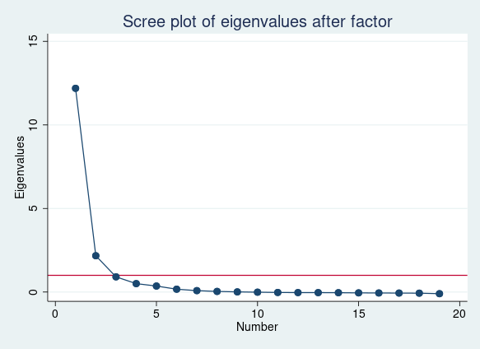
Scree Plot

Slide 5
Secondary Retained Factor Loadings
2 Factors with eigenvalue > 1
Why does factor 2 have negative and positive factor loadings for different questions?
These questions are all capturing positive qualities
What is this factor capturing?
Question | Factor 1 | Factor 2 | Uniqueness
Feel close to people in this school | 0.67 | -0.43 | 0.37
Happy to be at this school | 0.87 | -0.11 | 0.24
I am part of this school | 0.91 | -0.11 | 0.17
Teachers treat students fairly | 0.78 | 0.26 | 0.33
Feel safe | 0.84 | 0.12 | 0.27
School is clean and tidy | 0.56 | 0.43 | 0.50
Teachers communicate with parents | 0.85 | -0.03 | 0.28
Parents welcome to participate | 0.88 | -0.12 | 0.21
Staff take parent concerns seriously | 0.84 | 0.11 | 0.28
I try hard to make sure I am good at schoolwork | 0.78 | -0.50 | 0.14
I try hard because I am interested | 0.71 | -0.39 | 0.35
I work hard to understand new things | 0.81 | -0.49 | 0.11
I am always trying to do better | 0.75 | -0.56 | 0.13
(There’s a teacher or adult…) who really cares about me | 0.78 | 0.41 | 0.23
who tells me when I do a good job | 0.86 | 0.32 | 0.16
who notices when I am not there | 0.70 | 0.51 | 0.25
who wants me to do my best | 0.88 | 0.06 | 0.21
who listens when I have something to say | 0.83 | 0.38 | 0.17
who believes I will be a success | 0.86 | 0.15 | 0.24

Slide 6
Parent Factor Loadings
 | Factor1 | Factor2 | Factor3 | Factor4 | Factor5
qoi9mean_pooled | 0.90 | 0.11 | 0.00 | -0.04 | 0.03
qoi15mean_pooled | 0.80 | 0.26 | 0.05 | 0.01 | 0.01
qoi16mean_pooled | 0.93 | -0.01 | 0.04 | -0.10 | 0.05
qoi17mean_pooled | 0.89 | 0.00 | 0.22 | -0.01 | -0.03
qoi27mean_pooled | 0.87 | -0.14 | 0.19 | 0.00 | -0.04
qoi30mean_pooled | 0.90 | -0.05 | -0.20 | -0.04 | -0.03
qoi31mean_pooled | 0.92 | 0.00 | -0.11 | -0.08 | -0.02
qoi32mean_pooled | 0.76 | -0.22 | -0.09 | 0.09 | 0.03
qoi33mean_pooled | 0.85 | -0.21 | 0.08 | 0.08 | 0.03
qoi34mean_pooled | 0.89 | 0.02 | -0.19 | 0.07 | -0.03
qoi64mean_pooled | 0.50 | 0.38 | 0.01 | 0.09 | 0.00

Slide 7
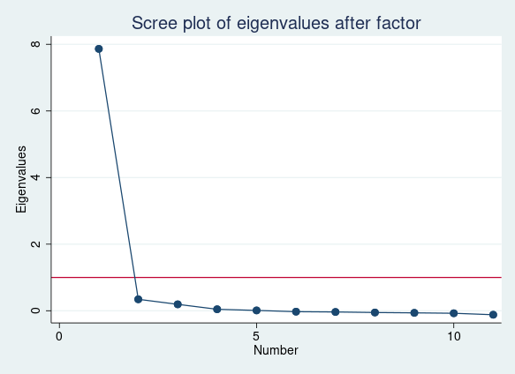
Scree Plot

Slide 8
Parent Retained Factor Loadings
 | Factor 1 | Uniqueness
qoi9mean_pooled | 0.90 | 0.19
qoi15mean_pooled | 0.80 | 0.37
qoi16mean_pooled | 0.93 | 0.14
qoi17mean_pooled | 0.89 | 0.21
qoi27mean_pooled | 0.87 | 0.25
qoi30mean_pooled | 0.90 | 0.19
qoi31mean_pooled | 0.92 | 0.15
qoi32mean_pooled | 0.76 | 0.42
qoi33mean_pooled | 0.85 | 0.28
qoi34mean_pooled | 0.89 | 0.20
qoi64mean_pooled | 0.50 | 0.75

Slide 9
Staff Factor Loadings
 | Factor1 | Factor2 | Factor3 | Factor4 | Factor5 | Factor6 | Factor7
provides adequate counseling and support services | 0.41 | 0.08 | 0.67 | -0.13 | 0.08 | -0.04 | -0.02
encourages students to enroll in rigorous courses | 0.12 | 0.05 | 0.38 | -0.09 | 0.03 | 0.27 | 0.02
has high expectations for all students | 0.74 | 0.34 | -0.01 | 0.13 | -0.03 | 0.07 | -0.08
feel a responsibility to improve this school | 0.67 | 0.39 | 0.17 | 0.20 | -0.22 | -0.03 | 0.02
motivates students to learn | 0.81 | 0.43 | 0.03 | 0.11 | -0.07 | 0.01 | -0.03
students are motivated to learn | 0.71 | 0.33 | -0.23 | -0.08 | 0.20 | 0.13 | -0.02
teachers communicate with parents | 0.69 | 0.42 | -0.15 | 0.00 | 0.02 | -0.01 | 0.05
cutting classes or being traunt | 0.54 | 0.35 | -0.46 | -0.08 | 0.18 | -0.09 | 0.04
meeting academic standards | -0.50 | 0.67 | -0.07 | -0.22 | -0.11 | -0.03 | -0.04
evidence-based methods of instruction | -0.51 | 0.67 | -0.03 | -0.22 | -0.09 | -0.03 | -0.05
positive behavioral support | -0.60 | 0.51 | 0.06 | 0.19 | 0.09 | -0.04 | -0.03
closing the achievement gap | -0.59 | 0.52 | 0.08 | -0.09 | -0.02 | 0.08 | 0.10
meeting social, emotional… needs of youth | -0.59 | 0.43 | 0.05 | 0.29 | 0.04 | 0.05 | 0.06
creating a positive school climate | -0.76 | 0.21 | 0.12 | 0.17 | 0.19 | 0.00 | -0.07
provides counseling… to help students… | 0.39 | 0.20 | 0.54 | -0.05 | 0.12 | -0.17 | 0.04

Slide 10
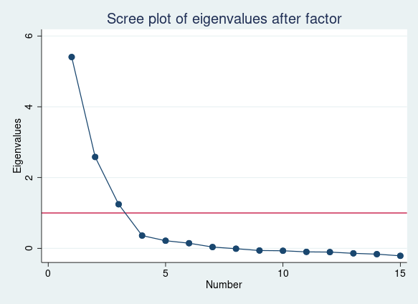
Scree Plot

Slide 11
Staff Retained Factor Loadings
 | Factor 1 | Factor 2 | Factor 3 | Uniqueness
qoi10mean_pooled | 0.41 | 0.08 | 0.67 | 0.37
qoi20mean_pooled | 0.12 | 0.05 | 0.38 | 0.84
qoi24mean_pooled | 0.74 | 0.34 | -0.01 | 0.33
qoi41mean_pooled | 0.67 | 0.39 | 0.17 | 0.37
qoi44mean_pooled | 0.81 | 0.43 | 0.03 | 0.15
qoi64mean_pooled | 0.71 | 0.33 | -0.23 | 0.34
qoi87mean_pooled | 0.69 | 0.42 | -0.15 | 0.33
qoi98mean_pooled | 0.54 | 0.35 | -0.46 | 0.36
qoi103mean_pooled | -0.50 | 0.67 | -0.07 | 0.29
qoi104mean_pooled | -0.51 | 0.67 | -0.03 | 0.29
qoi105mean_pooled | -0.60 | 0.51 | 0.06 | 0.38
qoi109mean_pooled | -0.59 | 0.52 | 0.08 | 0.38
qoi111mean_pooled | -0.59 | 0.43 | 0.05 | 0.47
qoi112mean_pooled | -0.76 | 0.21 | 0.12 | 0.36
qoi128mean_pooled | 0.39 | 0.20 | 0.54 | 0.51

Slide 12
Thank you!
California Department of Education
Jonathan Isler
Ryan Fuller
California Community Colleges Chancellor’s Office
Gary Adams
Todd Hoig
California State University Chancellor’s Office
Ed Sullivan
Matthew Case
Note: The research reported here was supported by the Institute of Education Sciences, U.S. Department of Education, through Grant R305H150073 to the Regents of the University of California. The opinions expressed are those of the authors and do not represent views of the Institute or the U.S. Department of Education, or of the agencies providing data.

